Slide 1

Green University of Bangladesh
Department of Computer Science and Engineering (CSE)
Faculty of Sciences and Engineering
Spring 2024, B.Sc. in CSE (DAY)
Lab Report NO # 04
Course Title: Artificial Intelligence Lab
Course Code: CSE 316 Section: CSE 213 – D1
Problems / Tasks / Domains:
Write a program to perform topological search using IDDFS.
Student Details
Name | ID
Md. Shahidul Islam Prodhan | 213902017
Lab Assigned Date: 3rd April 2024
Submission Date: 14th May 2024
Course Teacher’s Name: Fairuz Shaiara, Lecturer
[For Teacher’s use only: Don’t write anything inside this box]
Lab Report Status
Marks: | Signature:
Comments: | Date:

Slide 2
1. TITLE OF THE LAB REPORT EXPERIMENT
Topological search using IDDFS.
2. OBJECTIVES/AIM
The primary objective of this project is to develop an efficient algorithm for performing a topological sort on a directed acyclic graph (DAG) using an Iterative Deepening Depth-First Search (IDDFS) approach. The key objectives are:
Topological Sorting: Implement a method to arrange the nodes of a DAG in such a way that for every directed edge from node A to node B, node A appears before node B in the ordering.
Iterative Deepening Depth-First Search (IDDFS): Employ the IDDFS technique to traverse the graph efficiently while maintaining a limit on the depth of exploration.
3. PROCEDURE / ANALYSIS / DESIGN
Analysis of Topological Sorting:
Explored the concept of topological sorting and its significance in various applications, such as task scheduling, dependency resolution, and more.
Studied existing algorithms for topological sorting, including Kahn's Algorithm, Depth-First Search (DFS), and variations like IDDFS.
Design of IDDFS Algorithm:
Formulated a plan to implement topological sorting using the IDDFS approach.
Analyzed the advantages of IDDFS over traditional DFS in terms of memory consumption and runtime efficiency.
Designed the Graph class to represent the graph structure and facilitate the topological sorting process.
Outlined the DFS-based IDDFS algorithm, emphasizing its iterative nature and depth limitation.
4. IMPLEMENTATION
The implementation phase involved translating the design into executable code:
Developed a Python script utilizing classes and functions to implement the IDDFS-based topological sorting algorithm.
Created a Graph class with methods for adding edges and performing the IDDFS traversal.
Translated the adjacency matrix representation of the graph into an adjacency list to facilitate efficient traversal.
Ensured proper handling of visited nodes, depth limits, and stack management during the IDDFS traversal.

Slide 3
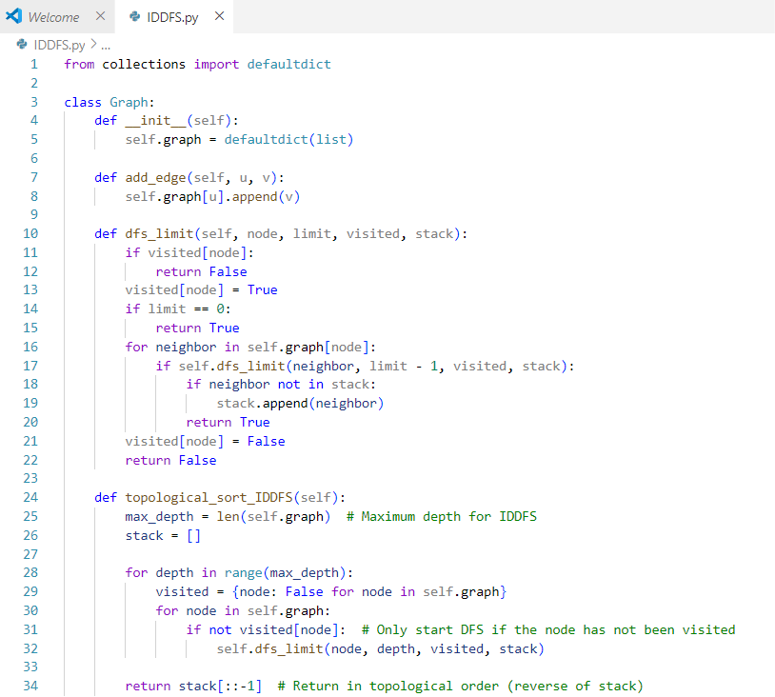
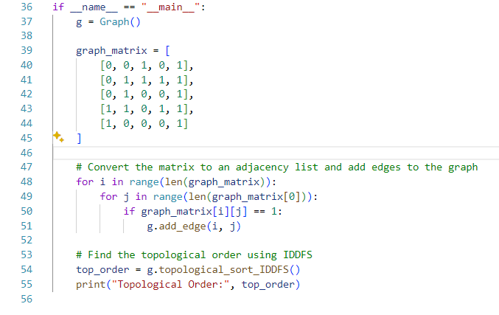
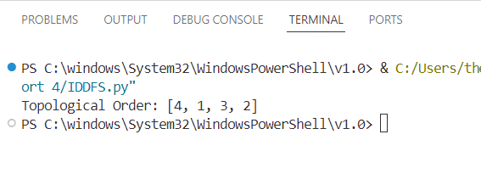
4. IMPLEMENTATION
Code
5. TEST RESULT / OUTPUT

Slide 4
6. ANALYSIS AND DISCUSSION
Upon completion of the implementation, the algorithm underwent rigorous analysis and discussion:
Correctness Verification: Checked the correctness of the algorithm by validating its output against known DAGs and theoretical expectations.
Performance Evaluation: Conducted performance testing to assess the algorithm's efficiency in terms of runtime and memory consumption for graphs of varying sizes.
Scalability Assessment: Evaluated the scalability of the algorithm by analyzing its behavior with increasingly larger graphs.
Comparison with Other Algorithms: Compared the performance and characteristics of the IDDFS-based approach with traditional DFS and other topological sorting algorithms.
7. SUMMARY
In summary, this chapter outlined the objectives, procedure, implementation details, analysis, and discussion pertaining to the development of an IDDFS-based topological sorting algorithm. The project successfully achieved its primary objective of implementing an efficient algorithm for topological sorting while utilizing the iterative deepening approach for improved traversal efficiency. The following chapters will delve deeper into the results obtained from the analysis and discuss potential areas for further research and optimization.

